Slide 1
Notes to the Presenter
Slides 2-10 contain notes for the presenter and are hidden.
You may include your picture and company logo on the intro slide only
It is appropriate to provide a brief background (1 minute or less) on your organization.

Slide 2
Presentation Best Practices
Frame your presentation by answering:
What do you want your audience to learn?
What do you want your audience to do differently?
What result or outcomes do you want your audience to realize?
Clarify your session objectives at the beginning of your presentation.

Slide 3
Presentation Best Practices
Pictures speak 1,000 words; include a screenshot or picture on each slide to add visual interest.
A good goal is to aim for 7 words per slide.
Increase attention and interaction by using a variety of communication mediums, such as polls and videos.
Plan and follow a rough agenda including a breakdown by minute to help stay on track.

Slide 4
Example of Text Layout
Main topic 1: size 28pt
Size 24pt for the subtopics
Size 24pt for the subtopics
Main topic 2: size 28pt
Size 24pt for the subtopics
Size 24pt for the subtopics
Main topic 3: size 28pt
Size 24pt for the subtopics
Size 24pt for the subtopics

Slide 5
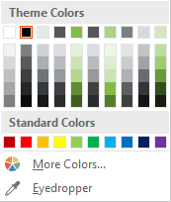
Slide Palette Info
The PowerPoint palette for this template has been built for you and is shown below. Avoid using too many colors in your presentation.
Select the 4th color from the left for subheads and 1st level non-bulleted text color, or wherever “color” text is preferred over the default black/white text
Accent colors 1-6 – (6 Theme Colors to the far right)
Text
Dark 2
Accent 1
Accent 2
Accent 3
Accent 4
Accent 5
Accent 6
Use Accent 1 as the main accent color. Use Accent 2 and Accent 3 when additional colors are needed.
Use Accents 4-6 sparingly – only when more colors are necessary.

Slide 6
Chart Example

Slide 7
Lots of data? Minimalize and Plan
Gray is used to de-emphasize data that is less important. Use cool gray 3 or cool gray 7. See slide 7 for color formulas.
All elements have the same interior margins as text blocks.
When a chart or graphic, has more elements than can easily be aligned to the grid, align the outer edges of the group, top, bottom, left and right edges to the grid.
It is preferable to keep the group aligned to the left border.
130M
140M
125M
Other
Other
Other
Other
Other
Other

Slide 8
Chart Example

Slide 9
Notes (hidden)
Some speakers like to use this slide for hidden “notes slides”.
Delete it if you don’t want to use it.

Slide 10



GLOBAL POWER PLATFORM BOOTCAMP
Organized Globally, Held Locally

Slide 11
Power Query: A Monster Machine on the Power Platform
Ahmed Oyelowo

Slide 12
Power Query: A Monster Machine on the Power Platform
Ahmed Oyelowo

Slide 13

Ahmed Oyelowo
Microsoft Certified Trainer
MCSA BI Reporting
Lover of Power Platform, Azure, SQL Server and R

Slide 14
<Breakout Session Title>
<List your session objectives>

Slide 15
Session Agenda
What is Power Query?- why it is amazing.
Demo: Using Power Query to extract data from Pdf Files.

Slide 16

What is Power Query?

Slide 17
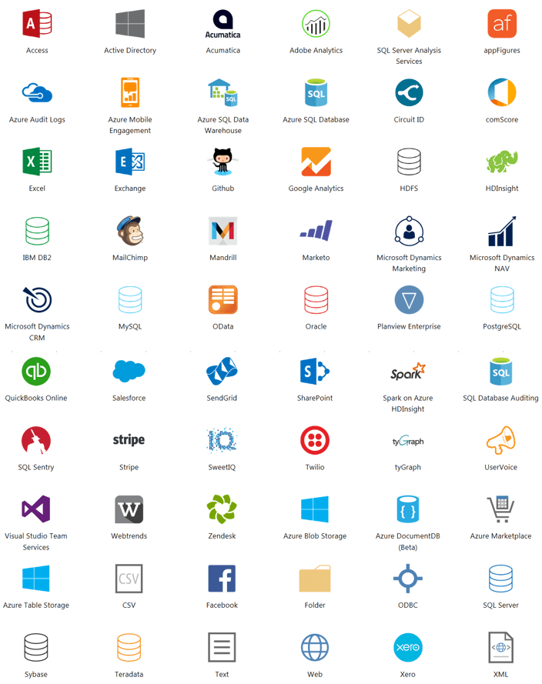
No-code Data Connectivity & Preparation Technology Powered by M Language

Slide 18





1 tool, many clients

Slide 19
Using Power Query to Extract Data From Multi-Pages PDF Files

Slide 20
Software code slide
This slide layout uses Consolas, a monotype font which is ideal for showing software code.

Slide 21
Any Questions?

Slide 22

Please fill out the survey! & Win Swags!!
https://www.powerplatformbootcamp.com/survey

Slide 23
Thank You For Attending

